Slide 1
Share | Learn | Inspire
Welcome

Slide 2
Vision: Share | Learn | Inspire
Events for you, focussing on your priorities
Approximately 5 a year
2018 – theme is Productivity
Case Study/ new technique, research
Sponsored events, no fee to attend
Virtual voluntary “committee”

Slide 3
It’s just a bit of banter, right?
Baljit Kaur
Diversity and Inclusion specialist
15 February 2018

Slide 4
Transparency
Weinstein effect
#Me Too
#TimesUp
The Everyday Sexism Project
Westminster Whatsapp
House of Commons Inquiry
Blogging – Uber
Yes at Google
Radio 5 Live survey
TUC survey – ‘Still just a bit of banter’
EHRC

Slide 5
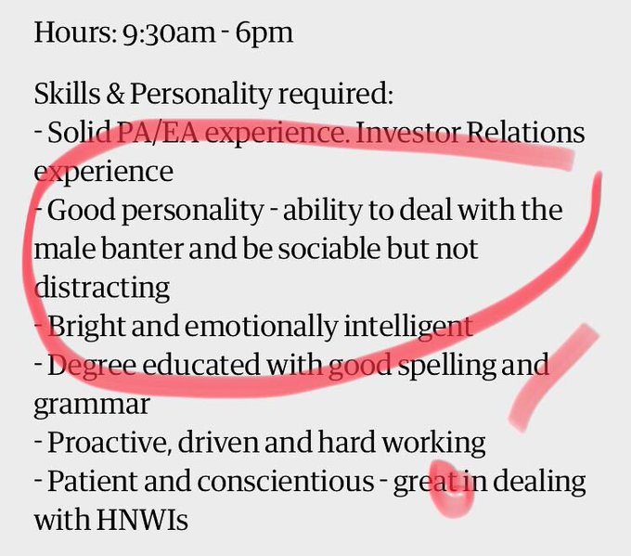
A long way to go…..!

Slide 6
Banter Bingo
Rate these statements/scenarios on a spectrum of acceptable to unacceptable.

Slide 7
Banter Bingo – examples of statements
“Just eat your lettuce and shut up”
“Wow, pink shirt, couldn’t you find something louder to wear?
“Can anyone tell me what’s happening to the [expletive] pope?”
“Men can’t multi task”

Slide 8
Harassment law
Behaviour will potentially amount to harassment if it is unwanted conduct that has the purpose or effect of:
violating a person’s dignity; or
creating an intimidating, hostile, degrading, humiliating or offensive environment for that person.

Slide 9
How would you respond?
Call it out
‘I’ statements
Make it safe
Ask why/what?
Did you know?
If it were you……
Tell me more…..

Slide 10
‘I wondered why somebody didn’t do something. Then I realised I am somebody’ Anon

Slide 11
Strategies to address banter in the workplace
Decode your policies
Cultivate positive cultures
Spotlighting – surveys, #Dignity
Practice greater candour

Slide 12
Nothing that makes people feel uncomfortable is acceptable.

Slide 13
Thank you.
For further information or queries, contact:
Baljit Kaur
Innate Consultancy
T: 07946 578364
E: baljit.kaur@innateconsultancy.co.uk
www.innateconsultancy.co.uk

Slide 14
Inspired to do…….

Slide 15
Share | Learn | Inspire: connect@valuingyou.co.uk
Slides, follow up …….
Next event: 15th March: Boosting Productivity through People
Watch for & circulate email for next event. Feedback
Sign up for Engage for Success Newsletter http://engageforsuccess.org/
Contribute:
If you are a proactive doer- volunteer for our virtual “committee”
A case study or technique
Host an event
What else?
Contact our volunteers:
Fiona Anderson, Founder: fiona.anderson@valuingyou.co.uk (sponsorship and future events)
John Travers, Co- Founder: johnctravers@hotmail.com (communications)
Baljit Kaur: baljit.kaur@innateconsultancy.co.uk (committed supporter)
Sue Petrie: petriesue@btinternet.com (committed supporter)

